Slide 1




Complying with Section 3 and Minority Owned and Women Owned Business Requirements
Notes:
Hello, my name is Prock Syanyara, a Compliance Specialist with the City of Moore. Welcome to the City of Moore’s Complying with Section 3 and Minority Owned and Women Owned Business Requirements Training.
This training is required for all contractors and their sub-contractors prior to starting work with the City’s Federal funded projects. In addition to the initial training, this training is also required on an annual basis.

Slide 2

Agenda
Background and Purpose of Section 3
Section 3 Covered Programs and Activities
Section 3 Residents and Businesses
Contractors Responsibilities
Notes:
This training will provide background and purpose of Section 3. Programs and activities that are covered by Section 3. Residents and Businesses covered by Section 3 and contractors’ responsibilities for compliance with Section 3 requirements.

Slide 3
Compliance with Section 3 Requirements
As a contractor or sub-contractor working on a project being paid for with Federal funds your company must comply with the requirements of Section 3
The City has posted the full Section 3 Plan on the Envision Moore Website at http://envision.cityofmoore.com/section-3-plan
Notes:
It is the policy of the City of Moore’s Capital Planning and Resiliency Department to require its contractors to provide equal employment opportunity to all employees and applicants for employment without regard to race, color, religion, sex, national origin, disability, veteran’s or marital status, or economic status and to take affirmative measures to ensure that both job applicants and existing employees are given fair and equal treatment. To this end contractors working with the City’s Federal funds projects, such as HUD funded projects, must comply with Section 3 requirements.
The Section 3 plan is posted on the Envision Moore Website at envision.cityofmoore.com/section-3-plan

Slide 4
What is Section 3
A Provision of the Housing and Urban Development Act of 1968 (as amended)
HUD’s legislative directive for providing preference to low and very low-income residents of the local community and the businesses that substantially employ them for new employment, training and contracting opportunities resulting from HUD-funded projects.
Notes:
Section 3 is a means to foster local economic development, neighborhood economic improvement, and individual self-sufficiency through housing and community development projects funded wholly or in part by a Federal funding source such as HUD - the Department of Housing and Urban Development.

Slide 5
Purpose
Section 3 directs recipients of certain HUD program funding to give preference for training and employment opportunities arising from those programs to local low-income residents “to the greatest extent feasible”
Section 3 also directs recipients to give preference in awarding contracts to businesses owned by or employing local, low-income residents “to the greatest extent feasible”
Recipients of Section 3 covered assistance must make every effort to recruit, target and direct economic opportunities to Section 3 residents and businesses
Notes:
The purpose of Section 3 of the HUD Act of 1968 as amended by the Housing and Community Development Act of 1992, is to ensure that employment and other economic opportunities generated by certain HUD financial assistance shall, to the greatest extent feasible, and consistent with existing Federal, State and local laws and regulations, be directed to low-and very low-income persons, particularly those who are recipients of government assistance for housing, and to business concerns which provide economic opportunities to low and very low-income persons.

Slide 6
What Section 3 is Not
Not race or gender specific
Not an entitlement for eligible individuals and businesses
Not MBE/WBE (though MBE or WBE may also qualify as a Section 3 business)
Not a guaranty of jobs for low- and very low-income residents
Not optional– It’s the Law!
Notes:
Section 3 is a tool to provide opportunities to those who may not have otherwise. However, Section 3 is ...(read list from slide)
Compliance with Section 3 is required because it is the law.

Slide 7
CDBG-DR and Section 3
CDBG-DR projects that involve construction or professional services require Section 3 compliance. These specific areas are applicable to the City’s CDBG-DR efforts:
Infrastructure construction or repair
• Demolition
Construction of public facilities (includes parks and public buildings)
• Housing Construction or Rehabilitation
-including lead-based paint and asbestos abatement
Non-construction projects including
  Maintenance contracts
  Other professional service contracts
Notes:
Construction and professional service contractors receiving partial or full payment from the City’s Community Development Block Grant-Disaster Recovery funded projects are required to comply with Section 3. These projects include but are not limited to: infrastructure construction or repair, demolition, construction of public facilities including parks and public buildings, housing construction and rehabilitation, and non-construction projects including maintenance contracts and other professional services.

Slide 8
Section 3 Thresholds for CDBG and/or CDBG-DR
Section 3 requirements apply to contractors or subcontractors with contracts exceeding $200,000
Regardless of whether the contract is fully or partially funded with CDBG or CDBG-DR
If a contract contains multiple projects which collectively will exceed $200,000 – Section 3 applies
Section 3 requirements do not apply to material only contracts.
Notes:
Section 3 requirements apply to contractors and subcontractors receiving HUD funding exceeding $200,000 in any fiscal year cycle. Regardless of whether the contract is fully or partially funded by CDBG-Entitlement or CDBG-DR.

Slide 9
Section 3 Triggers
Section 3 requirements are triggered when:
  A CDBG-DR project creates the need for new employment, contracting or training opportunities, or;
  When a contractor stated in responding to a RFP or RFQ that the contractor intends to utilize a Section 3 business in performance of the contract
Notes:
(Read from slide)

Slide 10
No Trigger - Reporting Required
If the expenditure of HUD funding does not result in new employment, training or contracting, Section 3 requirements are not triggered, but the contractor must still submit Section 3 reports
Recipients are not required to hire Section 3 residents or award contracts to Section 3 businesses other than what is needed to complete the HUD funded project
Notes:
Section 3 does not apply to contractors’ existing employees.
Section 3 is triggered and applies when contractors have to hire new employees, train, or contract to work on Federal funded projects.

Slide 11
What’s a Section 3 Resident
A resident of Public Housing or Indian Housing (located in the City of Moore)
OR
A resident of the City of Moore
AND
a low-income (80% of median) or
very low-income (50% of median) person
24CFR Part 135.8(3)
Notes:
Section 3 residents are those individuals who are low-income, 80% of median or lower and reside in the City of Moore; or Individuals who reside in Public Housing or Indian Housing located in Moore.

Slide 12
Section 3 Resident Thresholds
Check Here If: |  | # of People in Household: | Gross Income Is No Greater Than:
 |  | 1 | $36,150
 |  | 2 | $41,300
 |  | 3 | $46,450
 |  | 4 | $51,600
 |  | 5 | $55,750
 |  | 6 | $59,900
 |  | 7 | $64,000
 |  | 8 | $68,150
I affirm that the above statements are true, complete, and correct to the best of my knowledge and belief.
Signature
Printed Name
Date
Notes:
This table provides a current Section 3 resident Thresholds based on gross income and number of people in the household.
An example of Section 3 qualified Resident is a new employee or new hired who lives in the City of Moore or Public Housing with 2 people in the household with $41,300 gross household income or less is a qualified Section 3 Resident.

Slide 13
Order of Preference for Section 3 Residents
Section 3 residents receive preference for training and employment opportunities generated by CDBG-funded projects and activities based on the following order:
• Residents of the service area or neighborhood in which the covered project is located (category 1 residents) – the service area is the City of Moore
• Participants in HUD Youthbuild programs (category 2 residents)
Other Section 3 residents
Notes:
The first preference for Section 3 Residents of Moore is to receive employment opportunities, or employment training.
The second preference for Section 3 Residents of Moore are to those participating in HUD Youthbuild programs.
Followed by other Section 3 residents of Moore, such as those residing in Public Housing or Indian Housing.

Slide 14
Contractor’s Outreach Responsibilities
Must reach out to the applicable employment/job development services of the agencies listed in the Resources section of the City’s Section 3 Plan.
May include other agencies and centers that serve the economically disadvantaged within the City of Moore'
The City will monitor evidence of compliance
Notes:
In meeting low-income resident employment requirements, contractors/ subcontractors are required to contact the employment/job development services of the agencies listed in the Resource section of the City’s Section 3 Plan and other agencies and centers that serve the economically disadvantaged within the City of Moore’s service area.

Slide 15

Section 3 Businesses
Notes:
The next training session looks at the definition of Section 3 Businesses.

Slide 16
Definitions: Section 3 Business Concern
A Section 3 Business Concern is defined as one that:
--is 51% or more owned by Section 3 Residents
OR
--whose permanent, full-time staff is comprised of at least 30% Section 3 Residents
OR
--has committed 25% of the dollar amount of its subcontracts to Section 3 Businesses
Notes:
To qualify for Section 3 Business status a business must meet one of the following:
51% or more of the business is owned by Section 3 Residents;
OR! At least 30% of the business’ permanent full-time employees are Section 3 Residents;
OR! The business is committed to subcontracting 25% of the project total dollar amount to Section 3 business.

Slide 17
Order of Preference for Section 3 Business Concern
For CDBG-funded activities, priority should be given to Section 3 Business Concerns as follows:
Section 3 businesses providing economic opportunities for Section 3 residents in the service area or neighborhood in which project is located
Applicants selected to carry out HUD Youthbuild programs
Other Section 3 businesses
Notes:
The first preference for Section 3 Businesses to receive contract will be given to the those providing economic opportunities for Section 3 residents residing in the City of Moore.
The second preference for Section 3 Businesses are to those selected to carry out HUD Youthbuild programs.
Followed by other Section businesses.

Slide 18
Eligibility for Section 3 Business Preference
Any business seeking a Section 3 contracting preference must certify that they qualify as a Section 3 business
Any Section 3 business seeking a contract or subcontract must submit evidence of their ability to successfully complete the contract, including Section 3 compliance
To register as a Section 3 business got to:
https://portalapps.hud.gov/Sec3BusReg/BRegistry/BRegistryHome
Notes:
To be eligible for Section 3 Business a contractor must: be certified as a Section 3 business. In addition, the contractor must prove its ability to successfully complete the contract including Section 3 compliance.
To register as a Section 3 business follow the link at the bottom of this Slide
Section 3: https://portalapps.hud.gov/Sec3BusReg/BRegistry/BRegistryHome

Slide 19
Section 3 Definitions: Covered Building Trades
Section 3 applies to CDBG-funded work associated with the following building trades
Carpentry
Masonry
Plumbing
Electrical
Demolition
Notes:
Building trades qualify for Section 3 businesses are: carpentry, masonry, plumbing, electrical, and demolition.

Slide 20

Section 3 Definitions: Covered Admin and Management Work
Section 3 applies to CDBG-funded work associated with the following services:
• Architectural
• Engineering
• Legal
• Management and administrative support
Notes:
Section 3 also applies to work associated with services such as: architectural, engineering, legal, and management and administrative support.

Slide 21
Eligibility for Employment and
Contracting
• A Section 3 Resident must meet the qualifications of the position to be filled
• A Section 3 Business Concern must have the ability and capacity to perform the task required
Notes:
Remember Section 3 is required by Federal funded projects to provide opportunities for those that may not have any. Opportunities do not mean must hired Section 3 qualified individuals and businesses. Employees and Businesses must also have the qualifications and abilities to fulfill work tasks.

Slide 22
Outreach to Section 3 Businesses
At a minimum, must consult the Section 3 Registry, and notify applicable parties of the opportunity
Post opportunities on the primary contractor’s website
File must contain evidence of compliance for each sub-contract over $200,000
The City will monitor performance
Notes:
Read from slide

Slide 23
Goals and Responsibilities
Notes:
In this section we will discuss HUD’s goals and the City of Moore and its contractors’ responsibilities.

Slide 24
Numerical Goals
• Employment:
30 Percent of new full-time hires or three out of ten new hires annually, should be qualified Section 3 Residents
• Contracts:
10 percent of the total dollar amount of all Section 3 covered contracts for building trades work
Three percent of the total dollar amount of all other contracts, such as professional services
Notes:
The goal for contractors to hire Section 3 Residents as full-time employees is at least 30% or 3 out of 10 new hires annually.
The goal for contracting with Section 3 qualified building trades is at least 10% of the total dollar amount.
The goal for contracting with professional services or other contracts is at least 3% of the total dollar amount.

Slide 25
Numerical Goals
continued
• Numerical goals are minimum targets to be reached for compliance
Contractors and sub-contractors are required to make best efforts to achieve these goals for employment and contracting
If the contractor or sub-contractor fails to meet goals, they must adequately document all efforts made to meet those goals
Notes:
(Read 2nd and 3rd bullets)

Slide 26
Section 3 Plan
The City’s Section 3 Plan is available in the Envision Moore website under the Capital Planning and Resiliency Department, in the Programs tab scroll down to “Plan” to locate “Section 3 Plan” http://cpr.cityofmoore.com/programs
The forms necessary for reporting are also located in the Capital Planning and Resiliency page in the “Forms” tab.
Notes:
(read from bullets)

Slide 27
Section 3 Reporting
Notes:
The next training section is on Section 3 Reporting and Forms

Slide 28
Frequency of Reporting
The City requires that all contractors and sub-contractors submit Section 3 Reports each week of the contract
  Even if there are no new hires
The City requires Section 3 Businesses be identified and reported in the first week of the Contract; and
In the week a new Section 3 Business is added
Notes:
(read from slide)

Slide 29
New Hires
For each new hire, the contractor and sub-contractors are required to include the Section 3 New-Hire form as part of the hiring process.
Instructions for completing the New Hire form are provided in VDR-05-A
The New Hire form is labeled VDR-05-B
The Weekly Summary of New Hires is labeled VDR-05-C
Notes:
(read from slide)

Slide 30
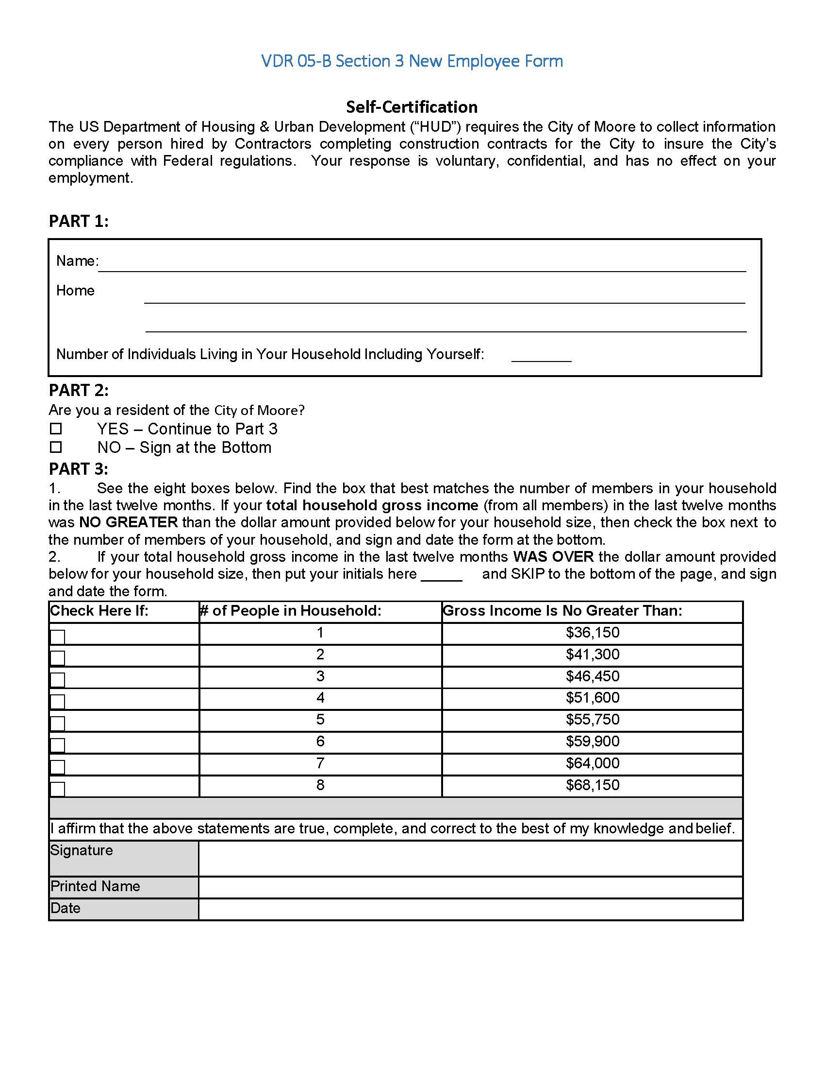
Notes:
THIS IS WHERE THE VIEWER SHOULD BE LED THROUGH THE FORM.
BE SURE TO ANSWER THE QUESTION OF HOW TO HANDLE THE PERSON WHO DOES NOT WANT TO PARTICIPATE
New Hire Form DVR-05-B is a self reporting by a new hired in the reporting period, if any. Part 1 asked for the new hired name, home address, and number of individuals living in the household. Part 2 is the first Section 3 qualification determination through residency; if the answer is “no” to being the resident in the service area then the new hired is not qualify for Section 3, check the box next to “no” and go to the bottom of the form, sign and print name.
If the new hired answers “yes” to being the resident in the service area then place a check next to “yes” and continue to the next part. Part 3 determines Section 3 income qualification using number of people in the household and maximum gross income. For example a number household and income of 4 people with $50,600 or less gross income qualifies the new hired for Section 3, check the box on the same line as the qualifying household then go to the bottom of the form to sign and print name. However, if the household income is $51,601 or more for a household of 4 people then the new hired is not qualified for Section 3, go to the bottom of the page to sign and print name.

Slide 31
New Hire Summary VDR-05-C
Submitted Weekly with Davis Bacon Report
If the contract is less than one calendar year, submitted at the end of a contract summarizing all new hires under the contract, or
If the contract crosses a calendar year, submitted by the 10th of January of the new year
Notes:
The New Hire Summary VDR-05-C:
Is used to submit Weekly with the Davis Bacon (or certified payroll) Report,
Or If the contract is less than one calendar year, then at the end of a contract the form is used to summarize all new hires under the contract,
Or If the contract crosses a calendar year, then the form is used to summarized all new hires within the calendar year and submit by the 10th of January of the new year

Slide 32
Summary VDR-05-C
Notes:
THIS IS WHERE THE VIEWER SHOULD BE LED THROUGH THE FORM.
BE SURE TO ANTICIPATE ANY QUESTIONS
The VDR 05-C Section 3 New Hire Weekly Summary must be completed for each project weekly during construction period by primary contractors and their subcontractors. No matter if you have new hired or not.
Enter the start date of week next to “Week Start Date” and enter end date of the week next to “Week End Date”.
The Work Order Number is the number assigned to the Project by the City of Moore. The Project number usually starts with “I” for infrastructure or “PF” for public facilities.
Project Address is usually the name of the Project assigned to the Work Order Number. For example, Work Order Number I-01-W-LMA Project Address would be Kingsmanor Street Repairs.
Essentially the Work Order Number and Project Address is given to the primary contractor in the Notice to Proceed Form.
Next to “General Contractor Name of Firm Completing this Form” enter the name your company.
In “The Firm Completing This Form is just answer the question “is your company a construction General Contractor? A construction Subcontractor? Or Professional Services Consultant?” check one box.
Next respond “yes” or “no” to the question “Did the Firm Hire Any Full or Part Time employees or Day laborers during the week?” If you check “no” skip the next section and go to the bottom of the form; the company’s officer must complete this section. However, the company officer can delegate this task to an office manager or other employee provided the company officer submit a signed letter granting authorization is submitted to the City of Moore.
If you check “yes” complete the “New Hire Matrix” section where you will enter the new hire’s name, address, section 3 eligible, and Labor Category or job classification, see the instruction page of the form to view list of job classification. The job classification is used to verify employees’ hourly rates using HUD’s wage determination.

Slide 33
Business Self Certification
All sub-contractors and contractors must complete the Self-Certification at the beginning of the Contract
All businesses added by a contractor must complete the Self-Certification at the beginning of the Contract
Notes:
(Read from slide)

Slide 34
Business Self Certification Criteria
Is your business currently certified as a Section 3 Business by a housing authority?
Is your business (51% or more) owned by individuals whose household incomes are below 80% of Area Median Income (AMI)?
Is your business (51% or more) owned by residents of housing authority?
Notes:
(read from slide)

Slide 35
Business Self Certification Criteria (continued)
Do 30% (or more) of your full time, permanent employees have household incomes that are BELOW 80% of Area Median Income (AMI)?
Are 30% (or more) of your full-time, permanent employees residents of a local housing authority?
Will you sub-contract more than 25% of this contract with any business that has any of the characteristics noted in the preceding questions?
Notes:
Other Section 3 Business Self Certification Criteria are
(read from slide)

Slide 36
BUSINESS CERTIFICATION VDR-05-E
Notes:
THIS IS WHERE THE VIEWER SHOULD BE LED THROUGH THE FORM.
BE SURE TO ANTICIPATE ANY QUESTIONS
The VDR 05-E Business Certification Questionnaire must be completed for every project by all developers, contractors, subcontractors, and professional service consultants involved in construction projects. The top section of the form collects the same information as the VDR-05-C Weekly New Hire form so we can skip to the section with the heading “Please answer each of the following questions”; this section will help the City of Moore determine if your company is a Section 3 business. Answer each question with “Yes” or “No”. If each question is not answered with a “Yes” or “No” then we will have to return this form for incomplete.
The last section affirms completion of form with the company’s officer or authorized person’s signature, name, and title .

Slide 37
Developer, Contractor Sub-Contractor Breakdown VDR-05-F
Summary of business certifications
Submitted at the beginning of the contract
Updated and submitted whenever a new sub-contractor is hired
Notes:
(read from slide)

Slide 38
VDR-05-F Form
Notes:
THIS IS WHERE THE VIEWER SHOULD BE LED THROUGH THE FORM.
BE SURE TO ANTICIPATE ANY QUESTIONS
The VDR-05-F Form is the breakdown list of Developer-Contractor- and their subcontractors. This form and the VDR-05-E Business Certification must be completed during the first week of the contract and must be updated whenever a sub-contractor is added.
VDR-05-f Form is pretty straight forward. The first row should be your company’s name, address, type of contract, and is this business a section 3 business, answer yes or no to the last column. The subsequent rows provide same type of information of your subcontractors, if any.

Slide 39
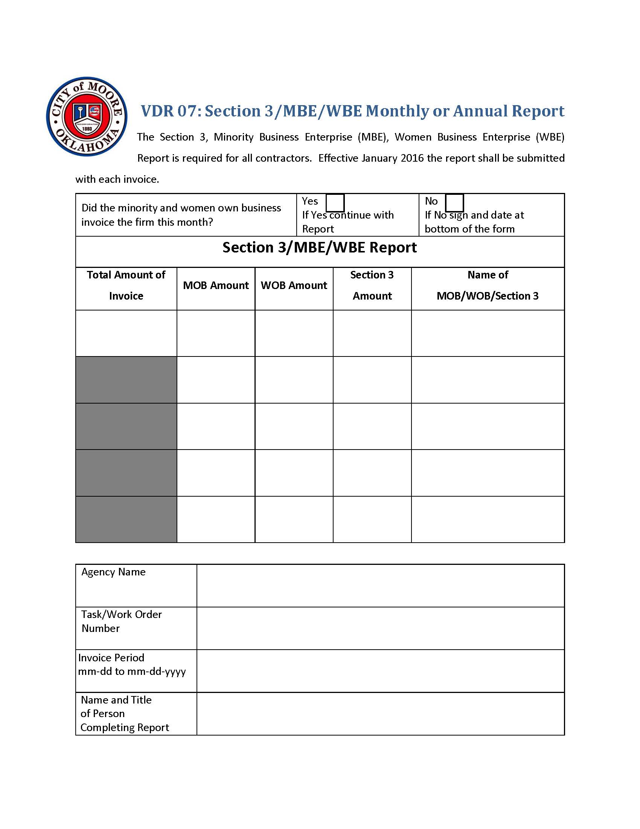
Section 3/MBE/WBE Report VDR-07
Notes:
The form is now different
THIS IS WHERE THE VIEWER SHOULD BE LED THROUGH THE FORM.
BE SURE TO ANTICIPATE ANY QUESTIONS
Form VDR-07: Section 3/MBE/WBE Monthly or Annual Report form needs to be submitted with every invoice. In the first column enter the total amount of the invoice, of the invoice amount enter the amount paid to minority business enterprise in the second column and amount paid to the women business enterprise in the third column. The forth column enter the total amount of the 2nd and 3rd columns. If no amount is paid to these entities enter zero in the appropriate columns. If the invoice has payment to the minority business enterprise and/or women business enterprise then enter the name of the agency in the last column of this form.
The last section of this form collects the name of the agency submitting the invoice, task or work order number the invoice is for, beginning and ending date of the invoice, and information of the person completing this form.

Slide 40
Section 3/MBE/WBE Report
VDR-07
Submitted with each invoice
  Even if the Contractor does not employ a Section 3 – Minority Business Enterprise or Woman Owned Enterprise
  If a developer or contractor stated they would use a Section 3 – Minority Business Enterprise or Woman Owned Enterprise in the RFP or RFQ the developer or contractor – must use the type of entity stated
    May be sanctioned for not using
Notes:
(read from slide)

Slide 41

Notes:
Contractors and subcontractors must complete this training during the contract set-up period and annually thereafter.
Who should receive this training? at minimum the Human Resource employee and the employee who is responsible for the actual week to week reporting.
To receive credit for this required training, please complete the form title “Section 3 Plan and Requirements Acknowledgement”.
Submit the completed form with original signature to the City of Moore.

Slide 42
Conclusion
Section 3 Compliance and Requirements
What is Section 3
Section 3 Residents
Section 3 Businesses
Section 3 Goals and Responsibilities
Section 3 Reporting and Forms
For questions or more information contact:
CJackson@cityofmoore.com
(405) 793-4572

